Slide 1
Hotel Aggregator Analysis
by Rahma Alam Samiha

Slide 2
Table of contents
01
02
03
04
05
06
Gegraphical Insights
Pricing & Availability
Host Performance
Review Scores & Guest Satisfaction
Property and Room Type Analysis
Recommendations

Slide 3
01
Geographical Insights

Slide 4
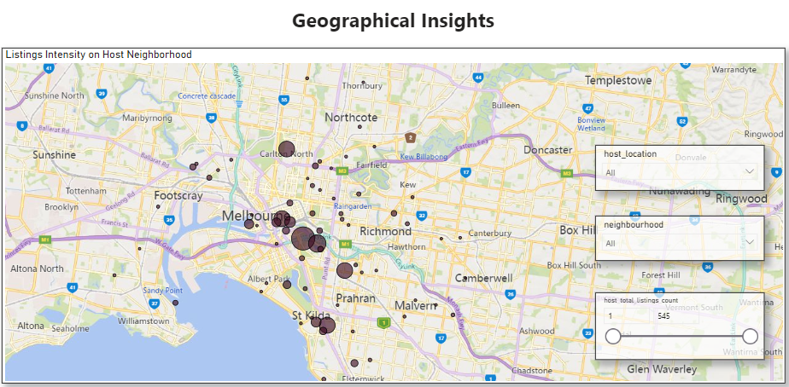
Distribution of Listings in Popular Host Neighborhood

Slide 5
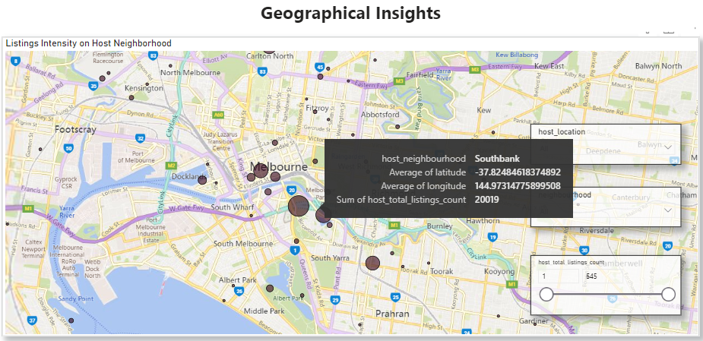
Host Neighborhood with the Highest Sum of Total Listings

Slide 6
02
Pricing & Availability

Slide 7
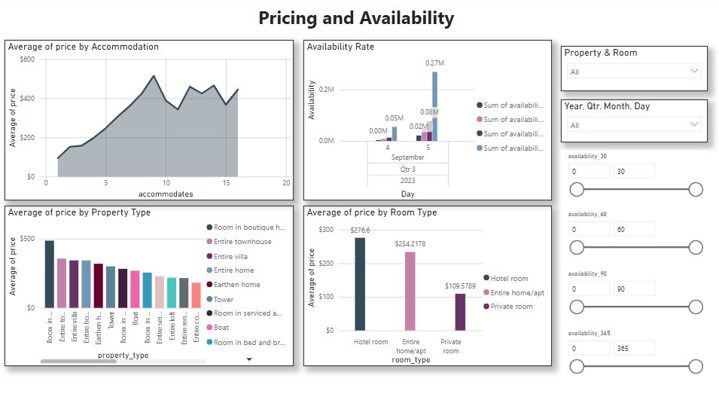

Slide 8
Pricing Trends Highest in Average
$ 514.9545
For 9 Accommodates
$ 486
$ 256.6
Room in Boutique Hotel
Hotel Room

Slide 9
Pricing Trends Lowest in Average
$ 93.9412
For 1 Accommodate
$ 69
$ 109.5789
Private Room in Home
Private Room

Slide 10
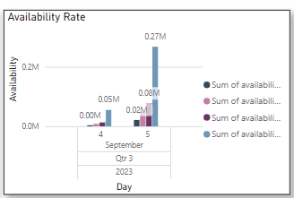
Peak Availability of Listings over Time
5th September, 2023

Slide 11
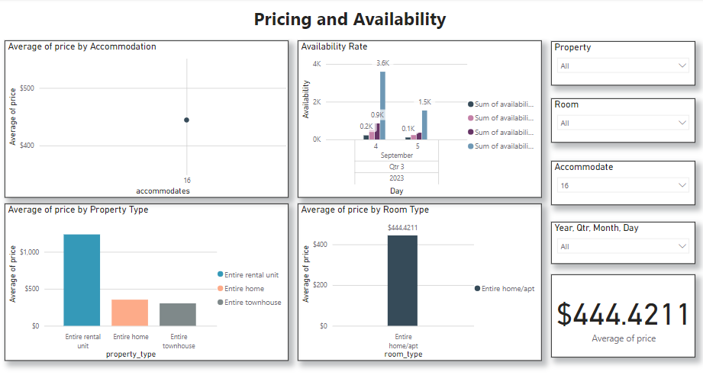
Pricing Trends Highest Accomodation

Slide 12
03
Host Performance

Slide 13
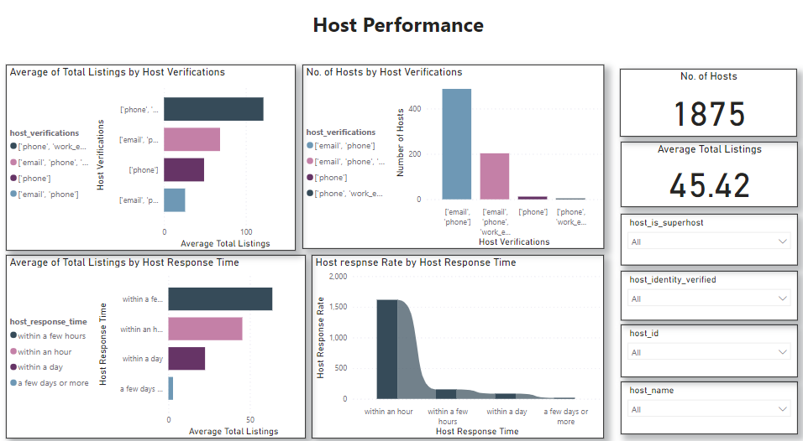

Slide 14
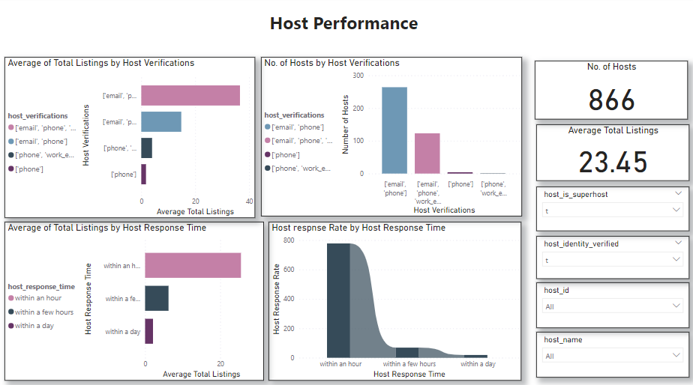
Superhost & Verfied

Slide 15
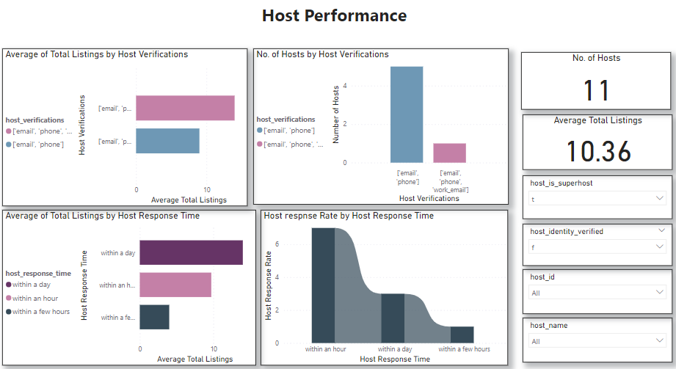
Superhost & Not Verfied

Slide 16
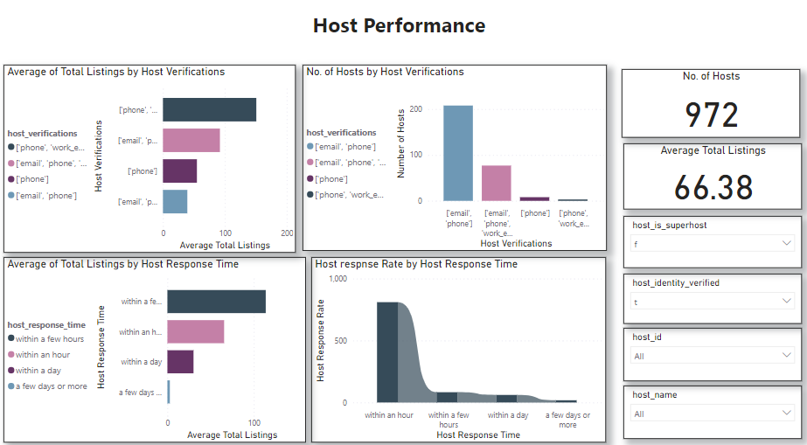
Verfied but Not Superhost

Slide 17
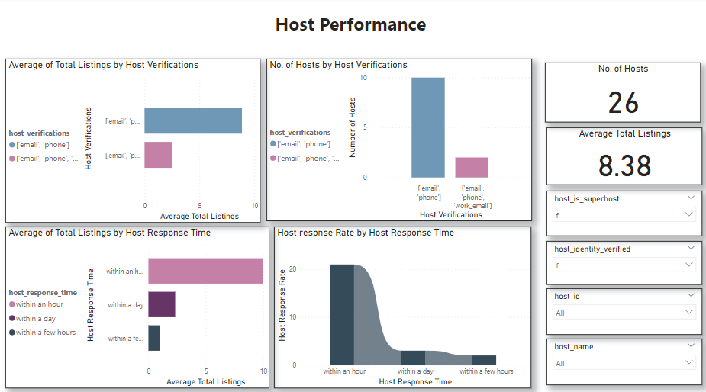
Not Verfied and Not Superhost

Slide 18
04
Review Scores & Guest Satisfaction

Slide 19
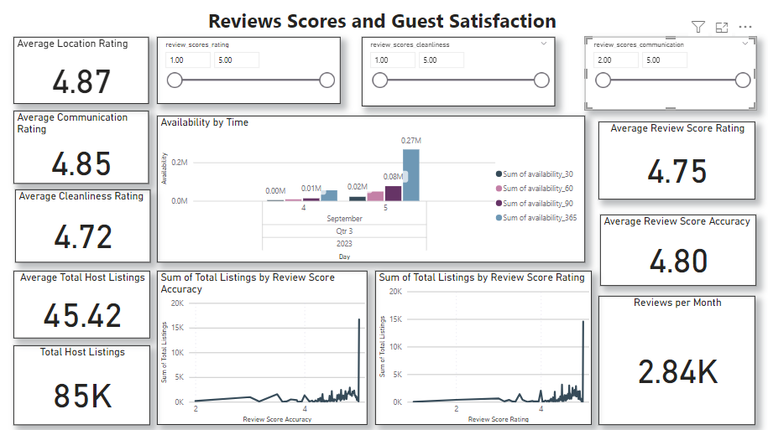

Slide 20
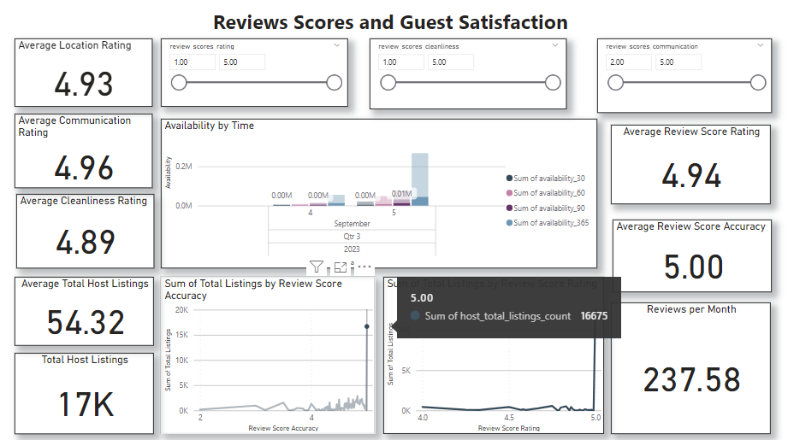
Listings Value with Highest Average Review Score Accurracy

Slide 21
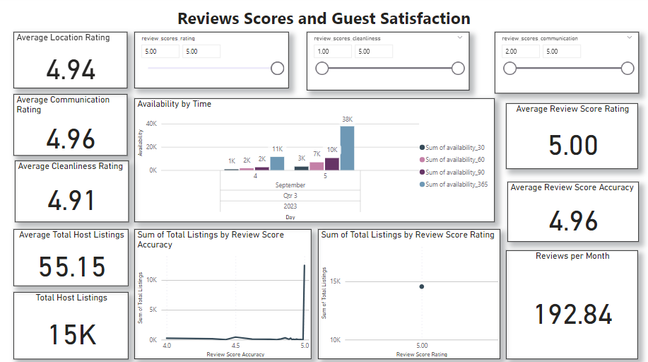
Listings Value with Highest Average Review Score Rating

Slide 22
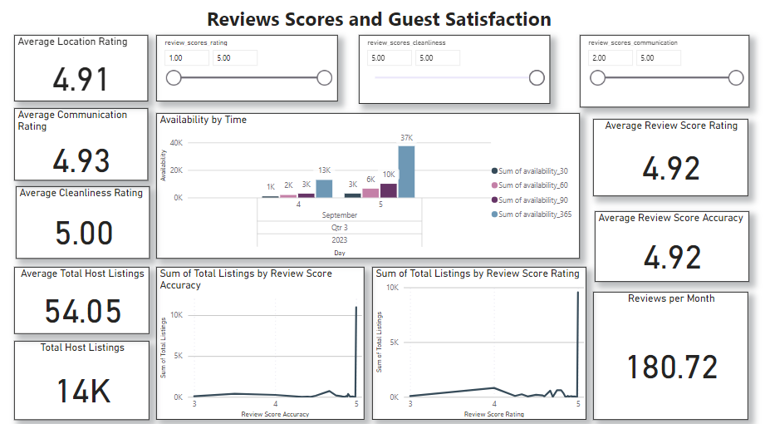
Listings Value with Highest Average Review Score for Cleanliness

Slide 23
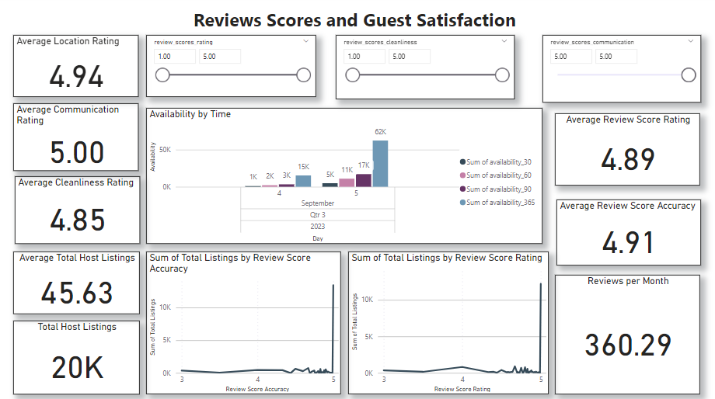
Listings Value with Highest Average Communnication Review Score

Slide 24
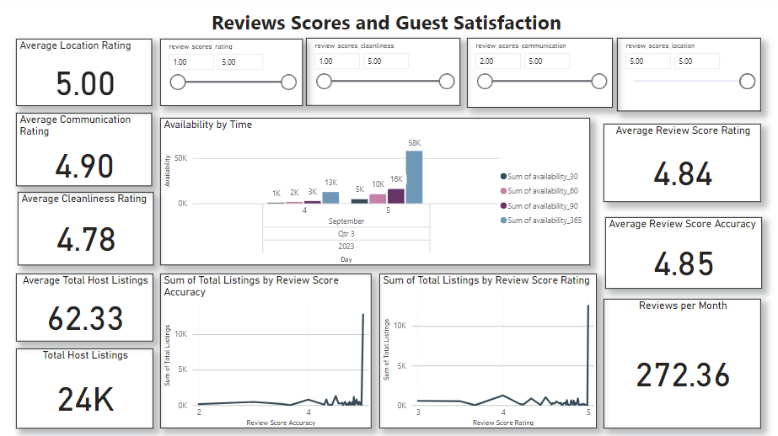
Listings Value with Highest Average Location Review Score

Slide 25
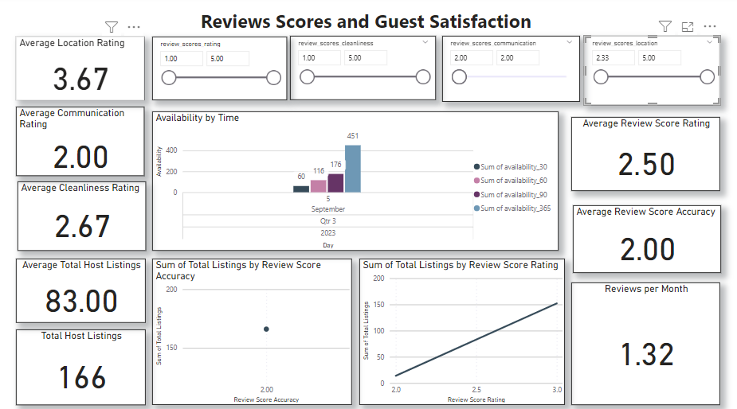
Listings Value with Lowest Average Communication Review Score

Slide 26
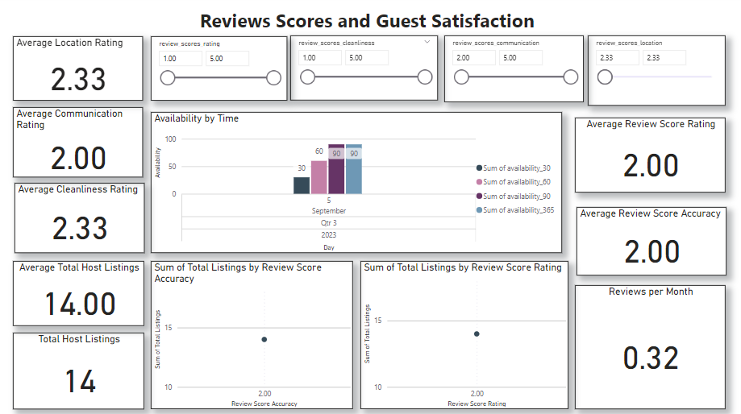
Listings Value with Highest Average Location Review Score

Slide 27
05
Property & Room Types

Slide 28
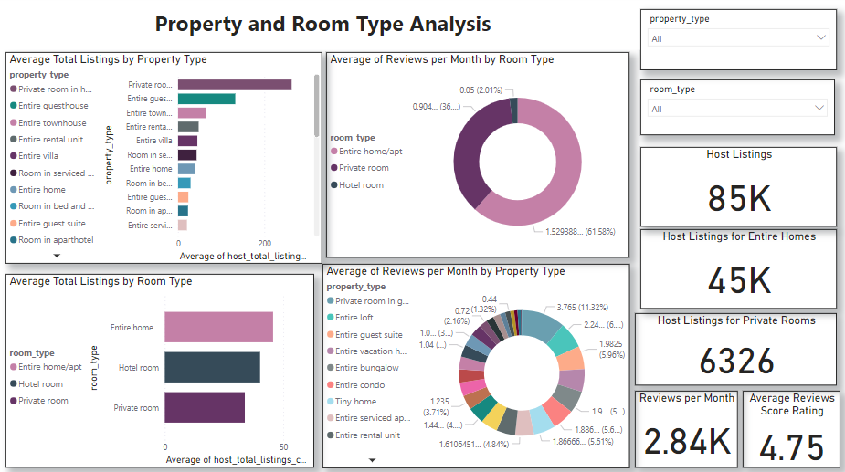

Slide 29
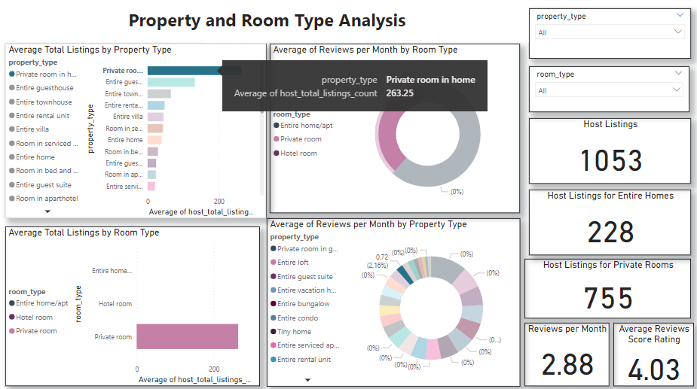
Property Type with Highest Average Listings

Slide 30
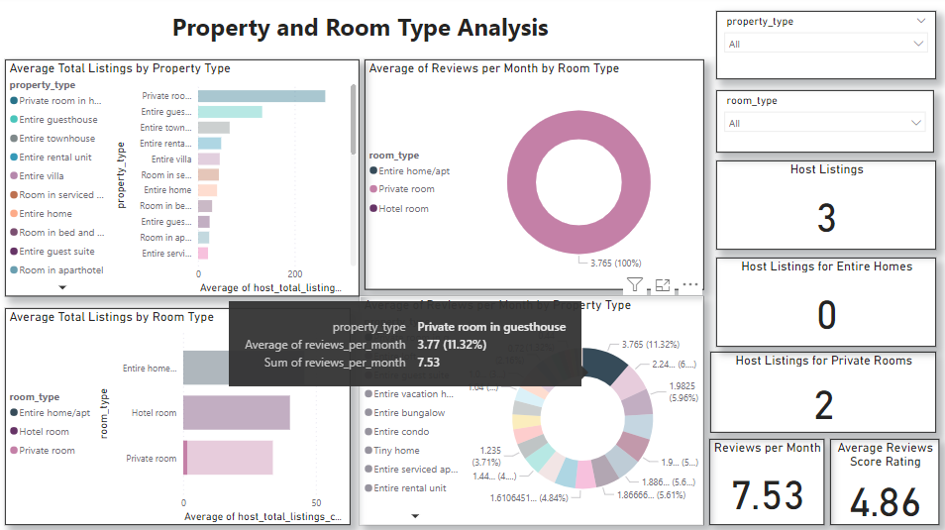
Property Type with Highest Average Monthly Review Ratings

Slide 31
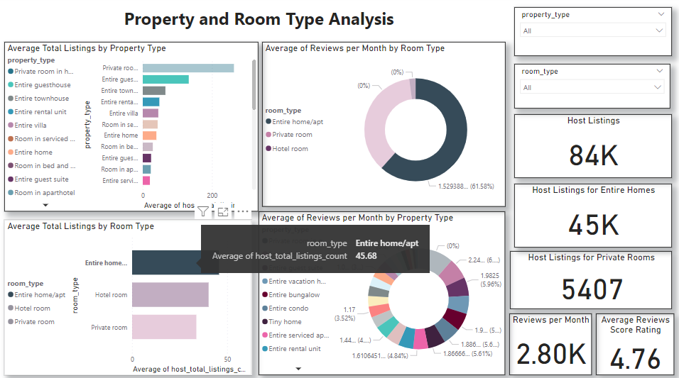
Room Type with Highest Average Listings

Slide 32
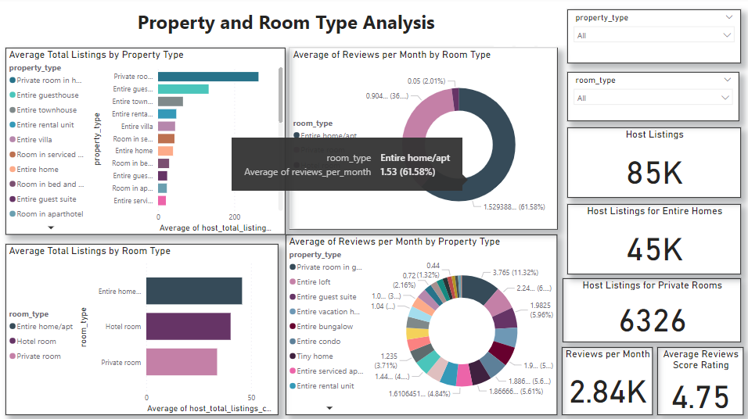
Room Type with Highest Monthly Average Reviews

Slide 33
06
Recommendations

Slide 34
Useful Recommendations
Expanding area towards host locations with higher intesity.
Data shows that larger accommodations tend to have higher prices. If larger properties are available, charging more could be possible.
Pay attention to the types of properties that are more popular or have higher average prices. For example, entire villas and townhouses seem to command higher prices. If these types of properties are available, highlighting them in listings could be beneficial.

Slide 35
Useful Recommendations
High availability on certain dates, like September 5th in the data, could indicate high demand. Increasing prices on these dates to maximize revenue could be a good strategy.
Data shows that entire homes/apartments are generally more expensive than private rooms and hotel rooms. Offering more entire homes/apartments, if feasible, could increase revenue.
Consider seasonality in pricing and availability strategy. Prices might be higher during peak tourist seasons and lower during off-peak times.

Slide 36
Useful Recommendations
Encourage hosts to verify both email and phone. Data shows that hosts with both email and phone verifications have the highest average total listings. This could lead to a larger inventory for the aggregator.
Encourage hosts to respond within an hour. Data shows that hosts who respond within an hour have the highest average total listings and a high response rate. This could lead to better customer satisfaction and potentially more bookings.
Consider promoting the benefits of becoming a superhost.

Slide 37
Useful Recommendations
Ensuring that guests’ expectations match their experiences can lead to higher review scores and more bookings.
Optimizing availability based on demand can help maximize bookings and revenue.
Consider the lowest review ratings in communication and locations, then the factors behind this low ratings. Improve communication as one low rating can highly affect other ratings, like location.
Note why some property or room types have high average total listings compared to others and find the common factors involving these types to improve.

Slide 38
That’s All!
Thanks a lot.

